Slide 1
Investigating Volumetric Analysis of Constituents Of Brain Soft Tissue Presented by Daniyal Ahmed Gul (BCS223030) Muhammad Hasan Nauman (BCS223033) Hadia Khan (BCS223216)
Supervisor: Dr Masroor Ahmed
Department of Computer Sciences, Capital University of Science & Technology, Islamabad

Slide 2
Introduction -Problem & Significance
The Problem: Manual segmentation of brain tissues (Gray Matter, White Matter, CSF) is time-consuming, prone to human error, and computationally expensive.
Significance: Volumetric changes are key indicators for Alzheimer’s, Multiple Sclerosis, and brain tumors.
Project Goal: The entire project is based only on 2D MRI slice analysis and segmentation.

Slide 3
Introduction - Proposed Methodology
THE PIPELINE Data Acquisition: MRI brain images used in this project were obtained from the Harvard Medical School Whole Brain Atlas.
Preprocessing: Resize, denoising, skull stripping, normalization, and contrast enhancement.
Feature Extraction: Texture, shape, and intensity-based feature analysis.
Core Analysis: Fuzzy C-Means (FCM) clustering for Gray Matter, White Matter, and CSF segmentation.
Final Output: Volumetric tissue percentages, ROI extraction, and dashboard visualization.

Slide 4
Functional requirements
S.no | Functional Requirements | Type | Status
1 | Researcher registers and logs into the system | Core | Completed
2 | Researcher uploads MRI images to the system | Core | Completed
3 | Automated preprocessing pipeline | Core | Completed
4 | System extracts texture features and shape features | Core | Completed
5 | FCM Tissue Segmentation | Core | Completed
6 | White Matter Analysis | Core | Completed
7 | Gray Matter Analysis | Core | Completed
8 | CSF Analysis | Core | Completed
9 | ROI Detection | Core | Completed

Slide 5
Non-Functional requirements
S.no | Non-Functional Requirements | Status
1 | Usability | Completed
2 | Performance | Completed
3 | Accuracy | Completed
4 | Scalability | Completed
5 | Portability | Completed
6 | Database Efficiency | Completed
7 | Visualization | Completed

Slide 6
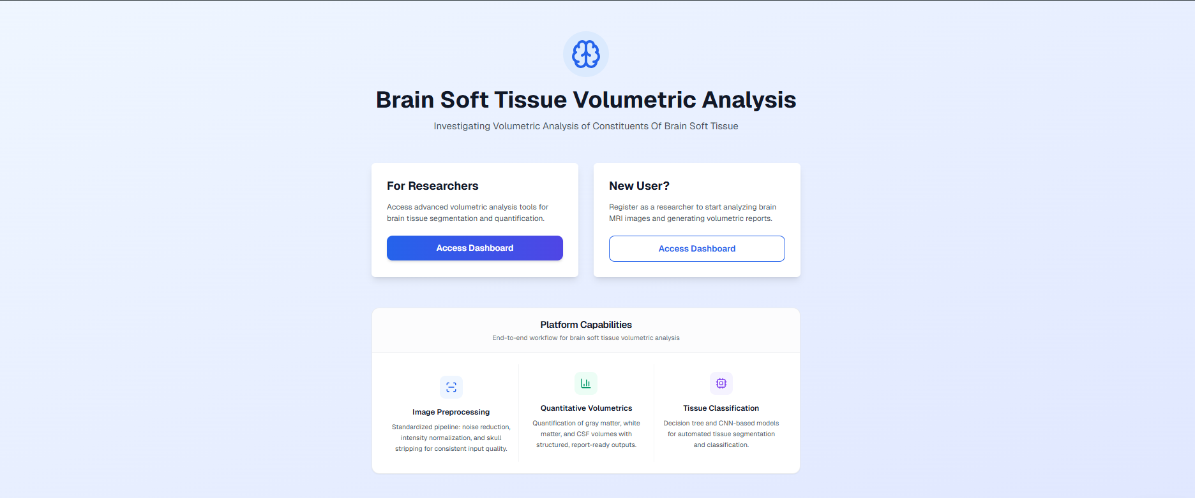
USER INTERFACE - LANDING PAGE
Key Features: Provides entry points for researchers and new users.
Highlights platform capabilities: Preprocessing, Volumetrics, and Classification.

Slide 7
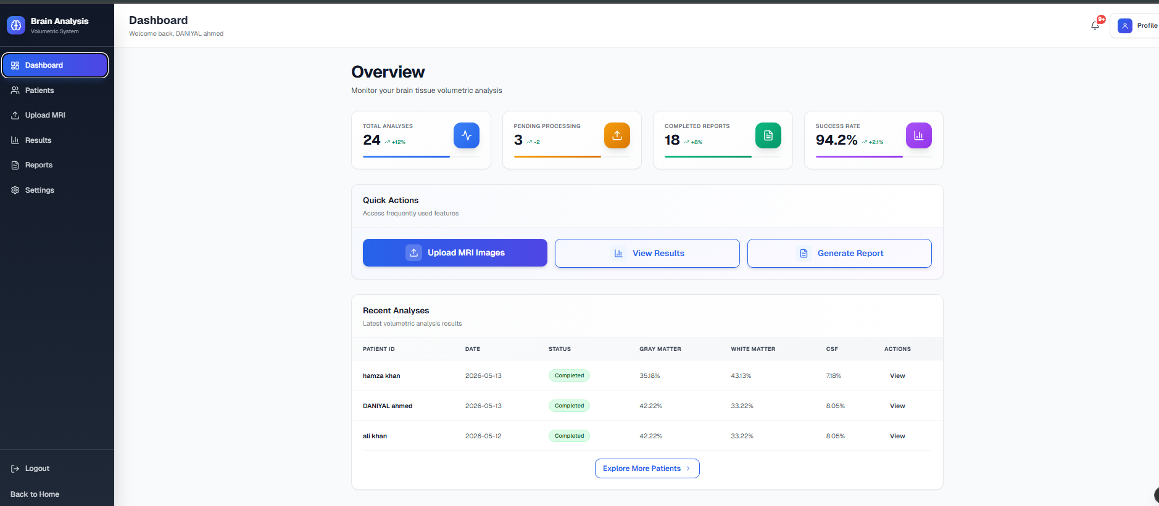
USER INTERFACE - DASHBOARD & AUTH
Functionality
Secure authentication
Dashboard provides "Quick Actions" for uploading images and generating reports.
Summary of total analyses and success rates.
Dashboard dynamically displays GM, WM, CSF volumetric percentages

Slide 8
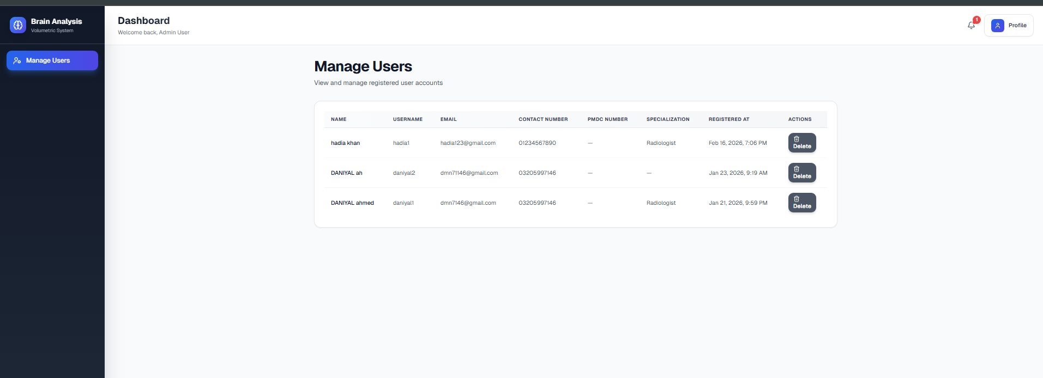
USER INTERFACE –ADMIN PANEL
Admin can manage registered users
View researcher information and registration details
Delete inactive or invalid accounts

Slide 9
Key Test Cases (Authentication & Upload)
Test ID | Objective | Input | Status
TC-01 | Verify Sign-in | Valid Credentials | Pass
TC-02 | Invalid Login Handling | Wrong Password | Pass
TC-03 | MRI Image Upload | png / .jpg file | Pass
TC-04 | Invalid File Format | .pdf file | Pass

Slide 10
Key Test Cases (Preprocessing & UI)
Test ID | Objective | Expected Result | Status
TC-05 | Preprocessing Execution | Resized, denoised, and skull-stripped image | Pass
TC-06 | Output Visualization | Display processed data on UI without distortion | Pass
TC-07 | FCM Tissue Segmentation | GM/WM/CSF masks generated | Pass
TC-08 | ROI Extraction | Suspicious region detected | Pass
TC-09 | Volumetric Ratio Calculation | Tissue percentages displayed | Pass

Slide 11
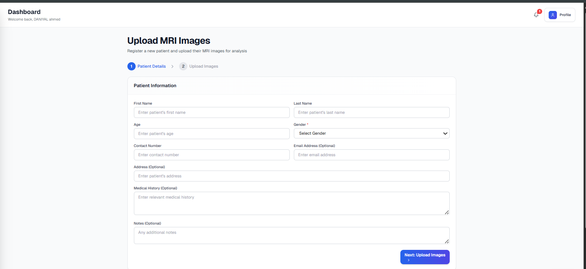
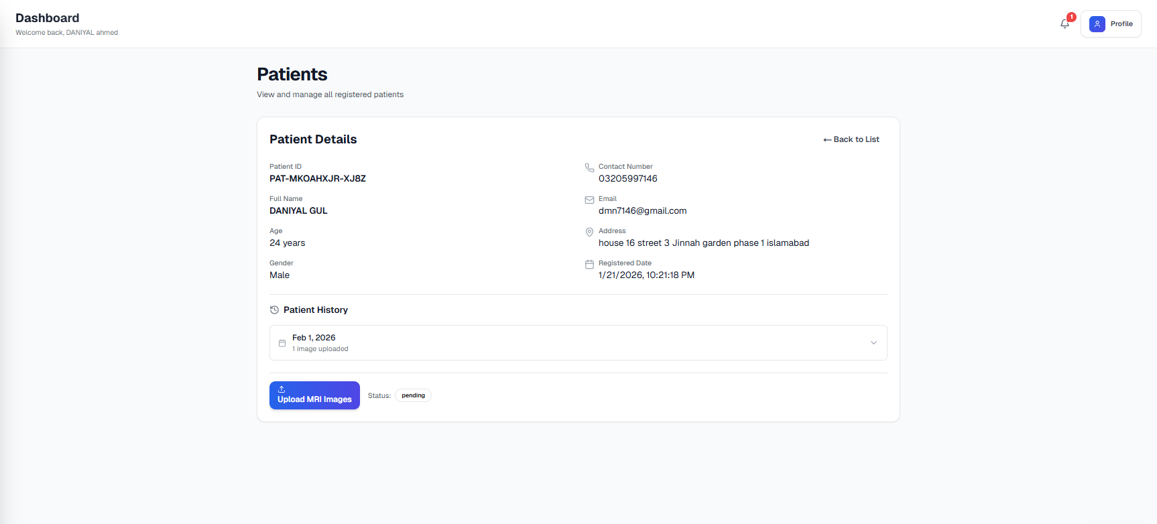
USER INTERFACE - MRI UPLOAD MODULE
Functionality
Link MRI images to specific patient records.
Supports multiple formats: JPG, PNG, DICOM, and NIfTI.
Backend processes images
Uploaded MRI scans are automatically passed through preprocessing and FCM tissue analysis pipeline.

Slide 12
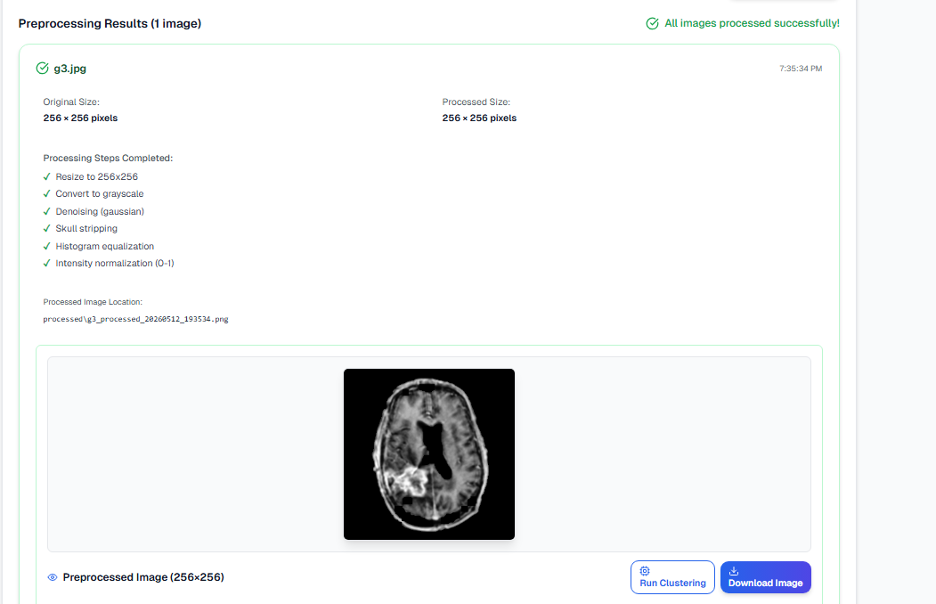
Backend MRI Processing & Tissue Segmentation
The fixed sequence of steps implemented
MRI image resizing and grayscale conversion
Denoising and skull stripping
Histogram equalization for contrast enhancement
FCM clustering for tissue separation
Gray Matter (GM), White Matter (WM) segmentation
CSF extraction
Morphological refinement
ROI (Region of Interest) detection
Final brain tissue analysis pipeline

Slide 13
MRI Processing & Segmentation ResultS
Results
MRI
Processed MRI
GM mask
WM mask
CSF mask
ROI detection

Slide 14
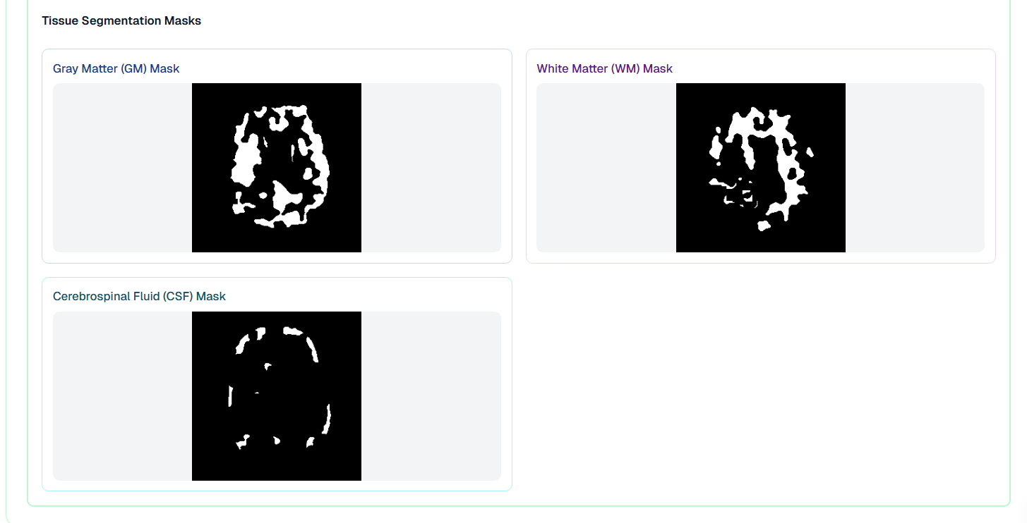
FCM Tissue Segmentation
• FCM clustering applied on MRI images
• Tissue regions segmented using intensity analysis
• Morphological filtering used for mask refinement
• Volumetric percentages calculated dynamically

Slide 15
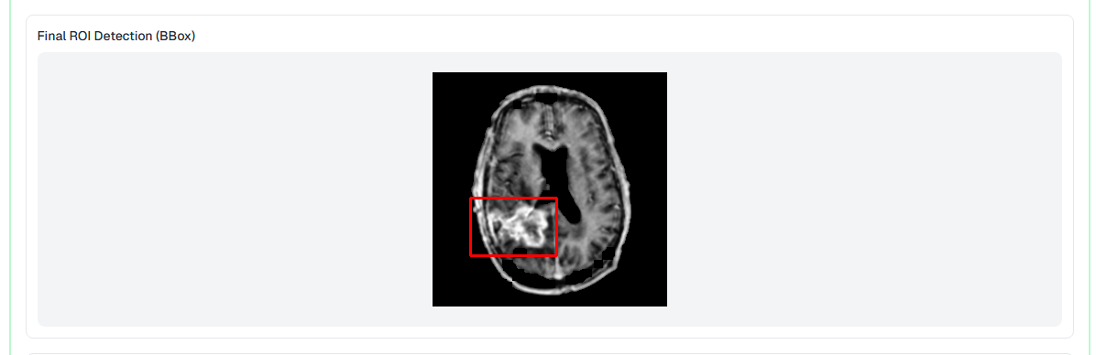
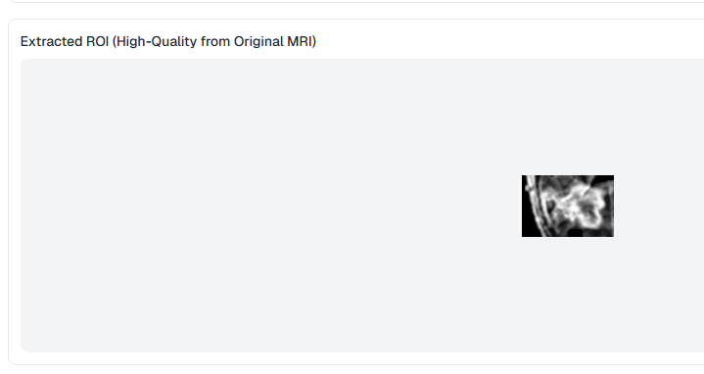
ROI Detection & Analysis
• Suspicious abnormal regions detected using morphology and connected component analysis
• ROI extracted from original MRI
• Tumor area and affected percentage estimated

Slide 16
Thank you

